Slide 1
Logistic Regression
Supervised Machine Learning
Classification Algorithm
© DataMites® and Skillogic® are part of Skillfloor Solutions Private Limited. All rights reserved

Slide 2
Course Topics
What is Logistic Regression?
How the algorithm works
Logistic Regression assumptions
Pros and Cons
Applications
Modeling Logistic Regression with Python

Slide 3
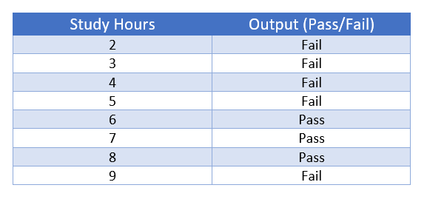
What is Logistic Regression?
Logistic Regression is a classification algorithm that can predict a categorical variable.
The dependent variable is a binary variable that contains data coded as 1 (Yes/True..) or 0 (No/False..).
The model arrives at the prediction by computing the probability of a class, say Class 1 to be the correct label.

Slide 4
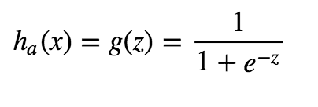
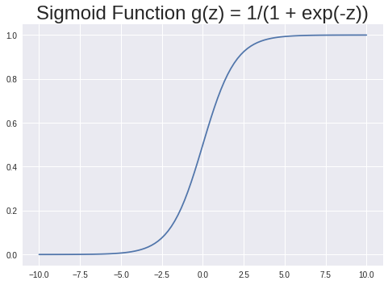
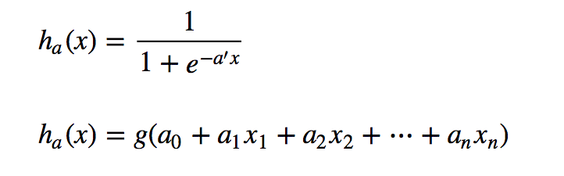
How Logistic Regression works?
Decision Boundaries
If h_{a}(x) >= 0.5 then we say y = 1
If h_{a}(x) < 0.5 then we say y = 0

Slide 5
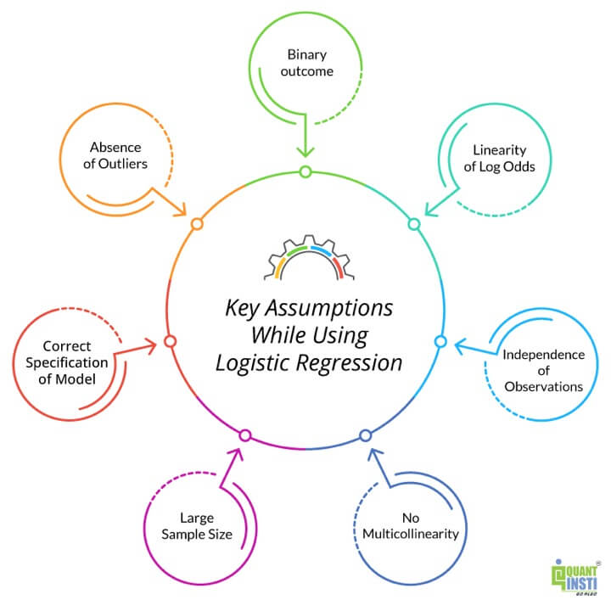
Assumptions of Logistic Regression
Binary Outcomes
Large sample size
No Multicollinearity
Absence of outliers

Slide 6
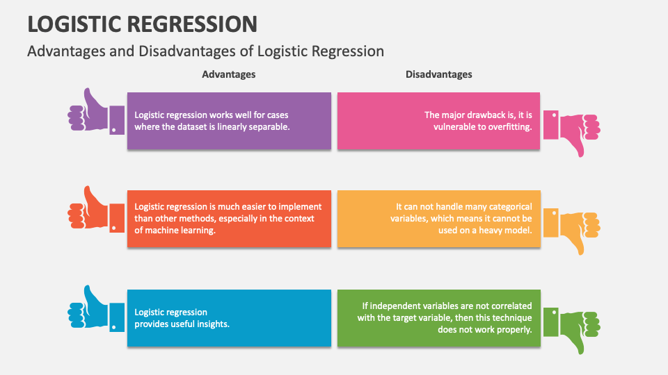
Pros of Logistic Regression

Slide 7
Cons of Logistic Regression

Slide 8


Applications of Logistic Regression
Image Segmentation and Categorization
Handwriting recognition
Spam filtering -- spam or not spam
Cell image -- cancer or normal
Production line part scan -- good or defective

Slide 9
Modeling Logistic Regression
Classification in action

